Slide 1

Louisiana Commission on
School and Nonprofit Security

Slide 2

2.0. Roll Call
Director of GOHSEP
House Homeland Security Chair
Senate Homeland Security Chair
Superintendent of Louisiana State Police
LA Sheriff’s Association Director
LA Interchurch Conference Director
LDOE Superintendent
Law Enforcement Commission Director
LA School Board Association Director
LA Assc. of School Superintendents Director
LA Assc. of Public Charter Schools Director
Chair of Nonpublic School Commission
Director of an OHSEP (Rural Area)
Director of an OHSEP (Metro Area)
LA Association of Chiefs of Police Director
LA Chapter Emergency Number Association President
LA State Fire Marshall
LA Department of Health Secretary
Department of Children & Family Services Secretary
Senate Education Committee Chair
House Education Committee Chair
LA Association of Educators Teacher
LA Teacher’s Federation Teacher
Legislative Youth Advisory Council Rep

Slide 3
3.0. Adoption of Agenda
1.0 CALL TO ORDER – PLEDGE
2.0 ROLL CALL
3.0 ADOPTION OF AGENDA
4.0 OLD BUSINESS
4.1. APPROVAL OF MARCH 2025 MEETING MINUTES
4.2. UPDATES FROM LCSS
4.3. UPDATES FROM LA STATE POLICE & FUSION CENTER
5.0 NEW BUSINESS
5.1. APPROVAL OF FY 26 GRANT AWARDS
5.2 UPDATE CONCERNING LCSS LEGISLATIVE REPORT
5.3. OPEN FOR ADDITIONAL NEW BUSINESS
5.4. PUBLIC COMMENTS
5.5. NEXT COMMISSION MEETING DATE
6.0 ADJOURNMENT

Slide 4
4.0 Old Business
    4.1 Approval of March 2025 Meeting Minutes

Slide 5
4.2. Updates from LCSS
A. Director of LCSS
Operational Calendar
10 JUL: Commission meeting
14-17 JUL: LA Police Chief's Association Conference (Baton Rouge, LA)
15 JUL: National Association for Threat Assessment Professionals (Baton Rouge, LA)
27-31 JUL: LA Sheriff’s Association Conference
27 JUL-2 AUG: 2025 National School Safety Conference (Las Vegas, NV)
28-30 JUL: VA School Safety Training Forum
4 AUG: Louisiana Behavioral Health Advisory Council
19 AUG: BESE BTAM/Outreach Presentation
28-29 SEP: LA Assistant Principals Fall Conference (Baton Rouge, LA)
Focus Areas
Revise 2025 LCSS Survey Questions (new data call) sent May 2025
RAVE/Panic button, ANON reporting, OUTREACH Roll Out (Threat Assessment)
FY 26 Grant distribution
Emergency Operations Plans and Physical Site Security Assessments
Bleed kit final distribution
Close out FY 24 Grants and FY 25 Grants (Dec 31)

Slide 6
4.2. Updates from LCSS
B. FY-24 Grant Update
  Grant recipients had until 30 June to submit reimbursement requests (unless
  granted an extension to August 31, 2025).
  Current Allocations:
    Pending Approval: $56,060.07
    Invoiced/Payed: $4,340,756.68
    Advanced Payment Request: $1,683,323.72
    $352,940.01 / $4,693,696.69
  Overall funds available have been reduced due to upcoming relinquishments.

Slide 7
4.2. Updates from LCSS
C. FY-25 Grant Update
  Current Allocations:
    Pending Approval: $209,439.34
    Invoiced/Payed: $1,327,487.31
    Advanced Payment Request: $281,400
    $1,608,887.31 / $5,000,267.43
  Project End Date: December 31, 2025

Slide 8
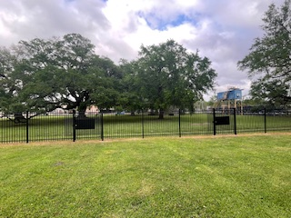
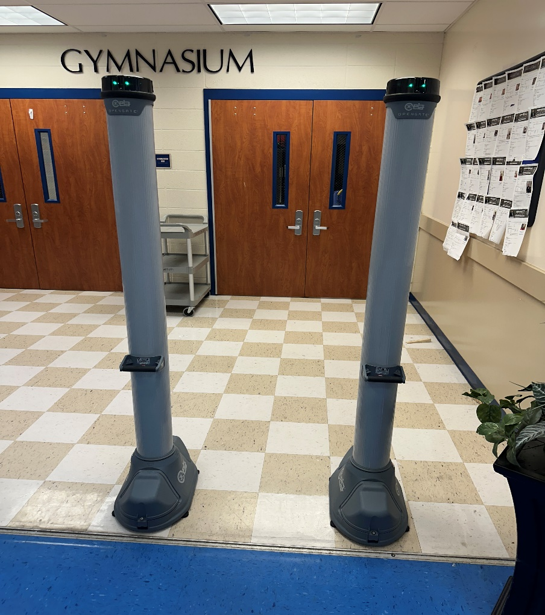
LCSS Grant Funds at Work

Slide 9
Louisiana Statewide Threat Assessment Outreach Initiative
Goals and Objectives:
  Deploy a Statewide Integrated Threat Assessment Tool and Central Reporting Mechanism
  Establish Threat Assessment Procedures, Guidelines, Protocols, and Processes
  Implement a Statewide Training Program
Outreach is a standardized integrated Threat Assessment Tool and Central Reporting Mechanism:
  The software platform is FERPA and HIPAA compliant.
  Violence Threat Risk Assessment (VTRA) Model – Three stage violence prevention model that addresses all forms of violence and includes a trauma-informed threat assessment framework that aims to identify and intervene within potential pathways to violence.
ACT 334 Creates the School Safety Act of 2023:
  Requires a district threat assessment team be created and provides they have input on the creation and revision of school crisis management and response plans.
  Develop, in consultation with the State Board of Elementary and Secondary Education, a statewide comprehensive school safety framework that includes a statewide behavioral threat assessment model and trauma-informed student support.

Slide 10
Louisiana Statewide Threat Assessment Outreach Initiative
Implementation Plan
Outreach Implantations Plan Phases: ( Outreach Legislative Funding)
Phase 1 – Initiation and Planning | February 2025 – March 2025
Phase 2 – Regional Engagement and Focus Groups | April 2025 – July 2025
Phase 3 – Initial Implementation Lunch – Rollout with three (3) parishes: Calcasieu, DeSoto, and Tangipahoa | June 2025 – October 1, 2025
Phase 4 – Full Statewide Implementation – Scheduling in Process, All School Districts across the State Trained and Connected to Outreach | Completed by May 31, 2026.
Phase 5 – Ongoing Support and Continuous Quality Improvement | On-going
Statewide VTRA Training Rollout
Violence Threat Risk Assessment (VTRA) Level I (Two-Day, In-Person) | School Year 2025-26
Violence Threat Risk Assessment (VTRA) Level II (Two-Day, In-Person) | School Year 2026-27
Violence Threat Risk Assessment Trained Trainer (VTRA) - Must have completed VTRA Levels I and II to qualify for this training, Two-Day, In-Person | School Year 2027-28
Traumatic Event Systems (Two-Day, In-Person) | School Year 2026-27

Slide 12
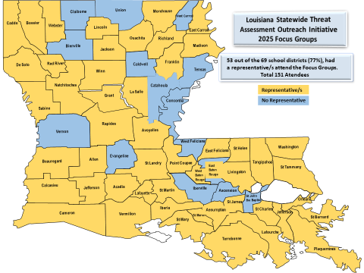

Slide 13
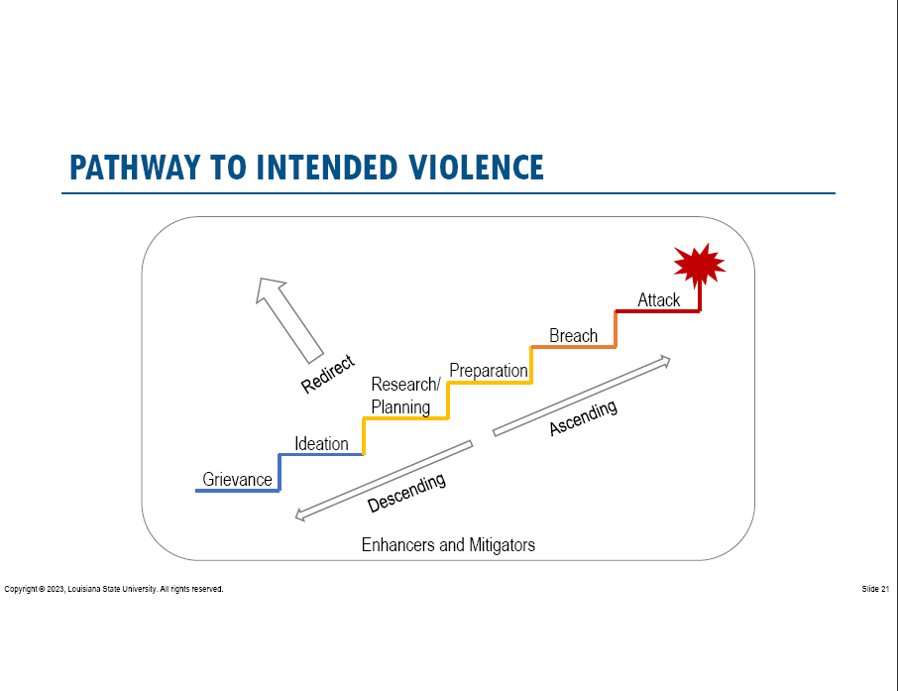
Louisiana Statewide Threat Assessment Outreach Initiative
Upcoming Events:
  Outreach Programming and VTRA Training to: Calcasieu, DeSoto, and Tangipahoa
  SR 119 – LCSS to develop and implement a system for collecting and reporting aggregated, non-identifiable data on suicide risk assessments conducted in public schools. In Partnership with Peer Initiative
  Louisiana Statewide Suicide Prevention Coalition
  Louisiana Mental Health Association
  Louisiana State Board of Elementary and Secondary Education (BESE)
  Louisiana Department of Health (LDH) Violence and Injury-Free Prevention Training Academy
  988 Advocacy Day at the Capitol
  Louisiana Behavioral Health Advisory Council
  Louisiana Association of Principals
  Louisiana Association of School Superintendents
Threat Assessment / Prevention:
  To evaluate the difference between making a threat and posing a threat to a school community and then to develop a management plan.
  Identification * Evaluation * Intervention * Resources * Follow-Up

Slide 14
F. Stop the Bleed Initiative
4.2. Updates from LCSS
Kits Issued as of 03/21/2025:
    SWAT-T: 904
    TMT: 525
    Curads: 609
    Total: 2,038 kits
Kits Issued as of 07/03/2025:
    SWAT-T: 972
    TMT: 691
    Curads: 699
    Total: 2,362 kits

Slide 15
IV. Updates from LCSS
G. Anonymous reporting
  Crime-stoppers:
  722 Schools: Grades 6 and above
  49 Parishes (54 Parish Partners once new On-Boarding is complete)
  On-Boarded Rapides Parish (11)
2024 2,327 tips which led to 6 arrests
2025 1,234 tips received from – March – June 30th, 2025 which led to 7 arrests
March 2025-June 2025: 170 Mental Health Tips and 424 threats of Violence Tips
2024-2025 School Year August 1 to date: 2,728 - Tips received
On-Boarding before the 2025 School Year: Grant Parish (8), Bienville Parish (7), Winn Parish (5), Catahoula Parish (5), Concordia Parish (7)

Slide 16
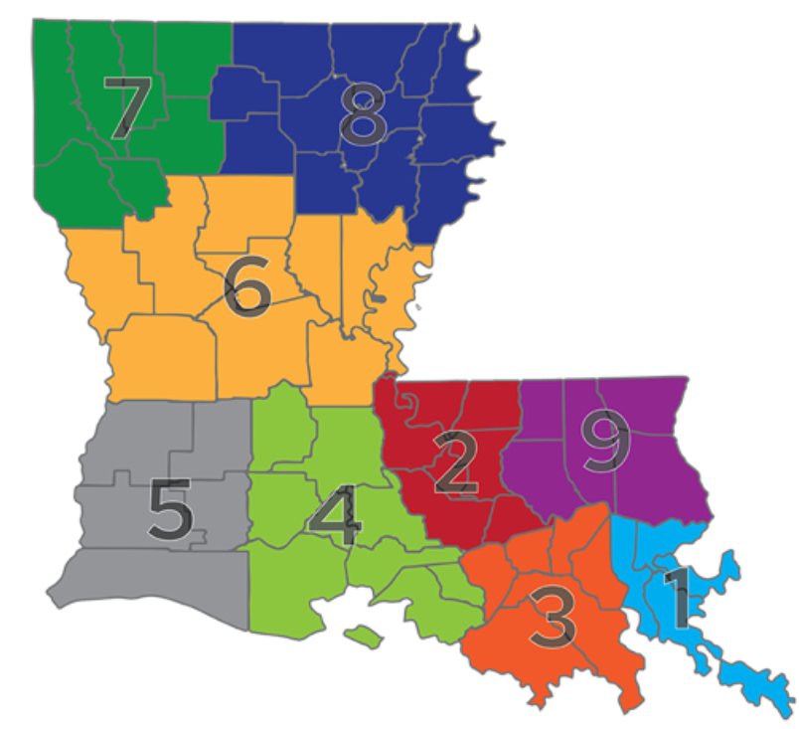
4.2. Updates from LCSS
Area Coordinator (Region 1,3,9)
16-Public Systems (358 schools)
Private, Charter, Archdiocese (258 Schools)
17 MAR Workshop with Tangipahoa Schools
18 MAR and 8 APR Training at St. John Parish School Board
29-30 APR New Orleans and Tangipahoa Focus Groups
8 May Presented at BESE-Authorized Charter School monthly meeting
May, June and July: Meeting with schools to discuss their EOPS, training plans
and doing walk-throughs of their campuses
August: Scheduling training with schools for initial in-services
Tangipahoa Parish is doing a Pilot for Outreach
Livingston Parish SRO Training
St. James 6/19/25 Mass Casualty Exercise-LERN
Lafourche 7/10/25 Mass Casualty Exercise-LERN
616 Schools
301,173 Students
In Addition:
Working with schools with grants FY24, FY25 and FY26 (253)
Requested Data Call Response
Assisting Schools with FY26 Grant applications
Assisting with anonymous reporting roll out
Attend personal development trainings & other conferences to promote LCSS.

Slide 17
4.2. Updates from LCSS
I. Area Coordinator (Region 2,4,5)
23 Public Systems (508 schools)
Charter/Non-public (113 Schools)
3 Catholic Diocese (60 Schools)
  Lake Charles
  Lafayette
  Baton Rouge
18 MAR: Assist with training for St. John Parish School Board
21-25 APR: VTRA & TES Training (New Threat Assessment)
6 & 8 MAY: Calcasieu and St. Martin Threat Assessment Focus Groups
MAY: Meet with 988 Providers to Coordinate Handoffs from GO SAFE LA
MAY: Conduct student focus groups for GO SAFE LA
22 JUL: Calcasieu Parish Outreach Pilot Meeting
23 JUL: Pointe Coupee District Training & School Walkthroughs
1 AUG: East Feliciana Run, Hide, Fight Training
6 AUG: Pointe Coupe School Level Trainings (Situational Awareness & ALICE)
AUG & SEPT: Meet with Schools/Districts to roll out GO SAFE LA
681 Schools
300,842 Students
In Addition:
Project Lead – New Anonymous Reporting System “Go Safe LA” & “Handle with Care” Project
Request & Follow Up with Schools for 2025 School Safety Survey
Assist schools with FY26 grant applications; FY24-25 closeouts
MAY, JUN, JULY - Attend school/district & parish level meetings to support school safety initiatives, emergency operation planning, AAR’s, and provide training as requested.
Attend personal professional development trainings & other conferences to promote LCSS.

Slide 18
IV. Updates from LCSS
J. Area Coordinator (Region 6,7,8)
2026 Grant Applications 214 / 2024-25 Applications 102
Region 6 – 55, Region 7 – 85, Region 8 – 74
Coordinate future training needs of the Regional Districts/Schools
Continue to track progress and audit the LCSS Grants
Verify and assist with the integration of the “Panic Button Systems”
with 911
Verify and assist with the integration of a anonymous reporting
system
Assist with Behavior Threat Assessment and Management System

Slide 19
4.3. UPDATES FROM LA STATE POLICE & FUSION CENTER

Slide 20
5.0. New Business

Slide 21
5.1 Approval of FY 26 Grant Awards
575 Applications Evaluated
~$25,769,000 in requested funds
All first-time recipients
111 applications approved across 50 Parishes

Slide 22
5.2. Update LCSS Legislative Report

Slide 23
5.3. Additional New Business

Slide 24
5.4. Public Comments

Slide 25
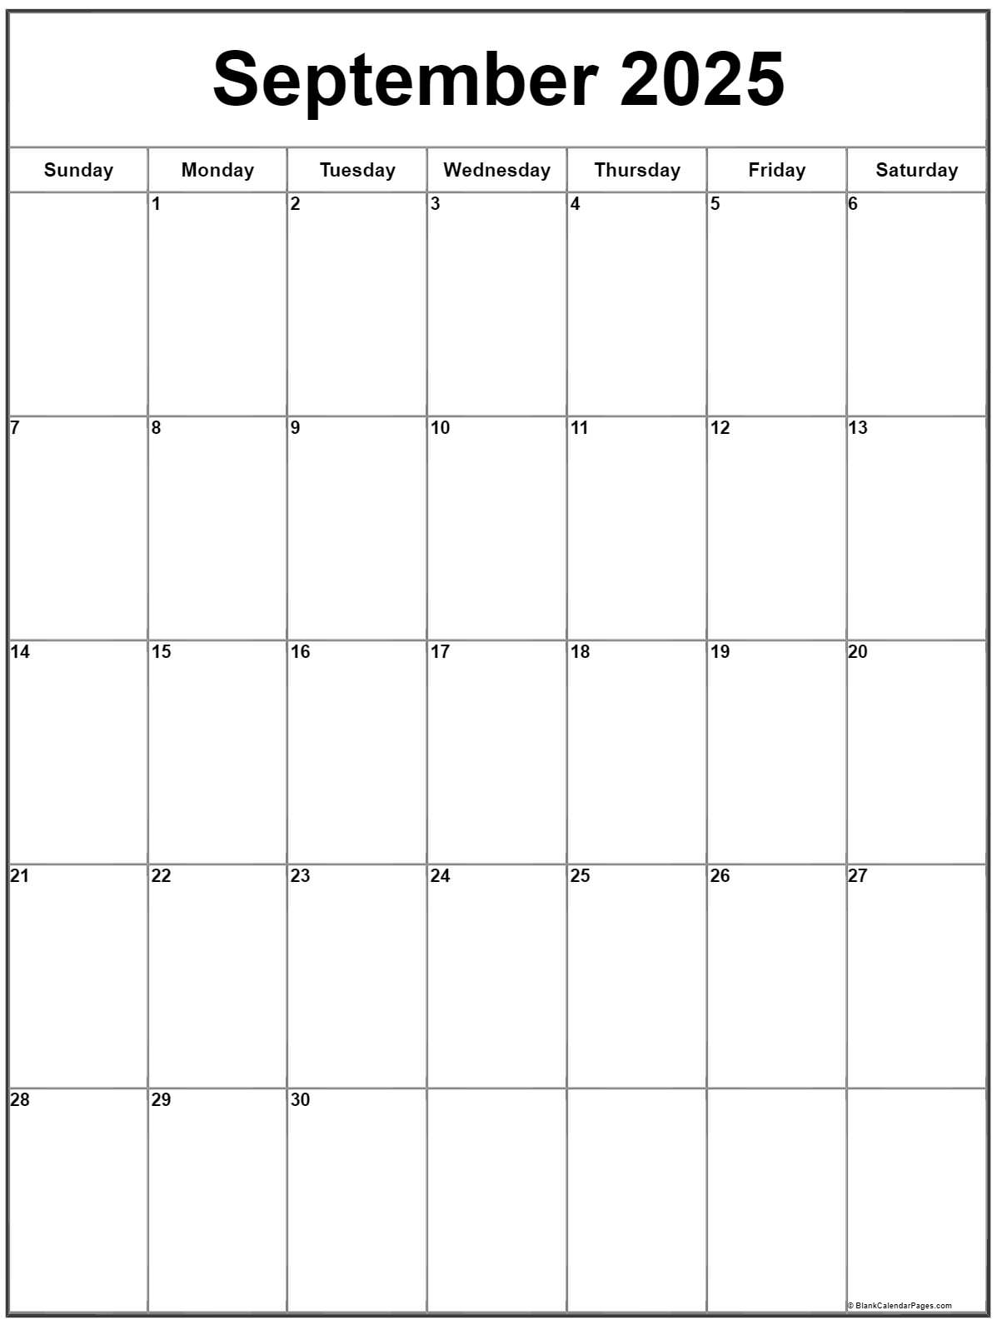

5.5. Next Commission Meeting Date
Mark your calendars!
The next Commission Meeting
will be held on September 30, 2025.

Slide 26
6.0. Adjournment
Thank you so much for attending!!!
We look forward to seeing you at the next meeting!

