Slide 1

Louisiana Commission on School and Nonprofit Security

Slide 2
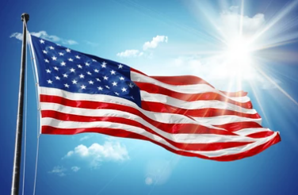
2.0 Pledge

Slide 3


3.0 Roll Call
Director of GOHSEP
House Homeland Security Chair
Senate Homeland Security Chair
Superintendent of Louisiana State Police
LA Sheriff’s Association Director
LA Interchurch Conference Director
LDOE Superintendent
Commission on Law Enforcement Director
LA School Board Association Director
LA Assc. of School Superintendents Director
LA Assc. of Public Charter Schools Director
Chair of Nonpublic School Commission
Director of an OHSEP (Rural Area)
Director of an OHSEP (Metro Area)
LA Association of Chiefs of Police Director
LA Chapter Emergency Number Association President
LA State Fire Marshall
LA Department of Health Secretary
Department of Children & Family Services Secretary
Senate Education Committee Chair
House Education Committee Chair
LA Association of Educators Teacher
LA Teacher’s Federation Teacher
Legislative Youth Advisory Council Rep

Slide 4

4.0 Adoption of Agenda
1.0 CALL TO ORDER
2.0 PLEDGE
3.0 ROLL CALL
4.0 ADOPTION OF AGENDA
5.0 OLD BUSINESS
5.1 APPROVAL OF SEPTEMBER 2025 MEETING MINUTES
6.0 NEW BUSINESS
6.1 UPDATES FROM LCSS
6.2 UPDATES FROM LA STATE POLICE & FUSION CENTER
6.3 GUEST SPEAKER MR. BROOKS DAVID, DISTRICT SAFETY OFFICER FOR VERMILLION PARISH SCHOOL BOARD
6.4 CONSIDERATION OF FY 24 GRANT CARRYOVER FUNDS FOR FY26 GRANT APPLICANTS
6.5 ADDITIONAL NEW BUSINESS
6.5.1 LCSNS VICE CHAIRMAN POSITION - OPEN
6.6 NEXT COMMISSION MEETING DATE
7.0 ADJOURNMENT

Slide 5
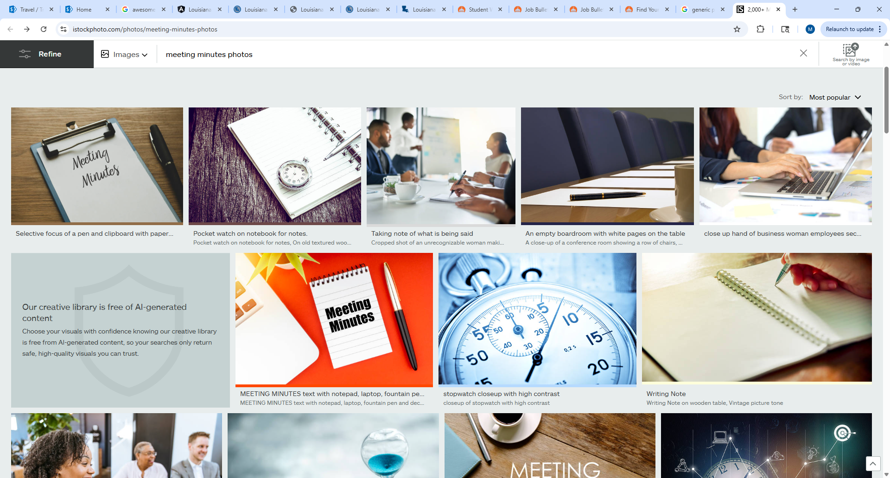
5.0 Old Business
5.1 Approval of September 2025 Meeting Minutes

Slide 6
6.0 New Business
6.1 UPDATES FROM LCSS
6.2 UPDATES FROM LA STATE POLICE & FUSION CENTER
6.3 GUEST SPEAKER MR. BROOKS DAVID, DISTRICT SAFETY OFFICER FOR VERMILLION PARISH SCHOOL BOARD
6.4 CONSIDERATION OF FY 24 GRANT CARRYOVER FUNDS FOR FY 26 GRANT APPLICANTS
6.5 ADDITIONAL NEW BUSINESS
6.5.1 LCSNS VICE CHAIRMAN POSITION - OPEN
6.6 NEXT COMMISSION MEETING DATE

Slide 7

6.1 Updates from LCSS
A. Director of LCSS
Operational Calendar
3 DEC: Website Redesign Meeting
7-9 DEC: LA Association of School Superintendents Conference
9 DEC: K-12 School Safety Task Force
20 DEC – 5 JAN: State Liberal Leave
2 JAN 2026: St. Michael Active Shooter Drill
22 JAN 2026: LA DOE School Safety Workgroup
Focus Areas
LCSS Website revisions (3 DEC 2025)
2025 LCSS Survey Questions (new data call)
RAVE/Panic button, ANON reporting, OUTREACH Roll Out (Threat Assessment)
FY 26 Grant distribution
Emergency Operations Plans and Physical Site Security Assessments
Bleed kit final distribution
Close out FY 24 Grants and FY 25 Grants (Dec 31)

Slide 8

6.1 Updates from LCSS
B. FY 24 Grant Update
Current Allocations:
Invoiced/Paid: $4,667,104.58
Advanced Payment Request: $1,683,323.72
$332,895.42 / $5,000,000

Slide 9

6.1 Updates from LCSS
C. FY 25 Grant Update
Current Allocations:
Invoiced/Paid: $3,013,627.20
Advanced Payment Request: $253,358.43
$1,986,640.23 / $5,000,267.43
Project End Date: December 31, 2025

Slide 10
LCSS Grant Funds at Work
Signage
Convex Mirrors
Fencing

Slide 11
LCSS Grant Funds at Work (cont.)
Gates/Access Control
Weapons Detection
Visitor Management

Slide 12

6.1 Updates from LCSS
D. FY 26 Grant Update
Current Allocations:
Invoiced/Paid: $0.00
Advanced Payment Request: $0.00
Balance: $5,000,000
Project End Date: August 31, 2026

Slide 13
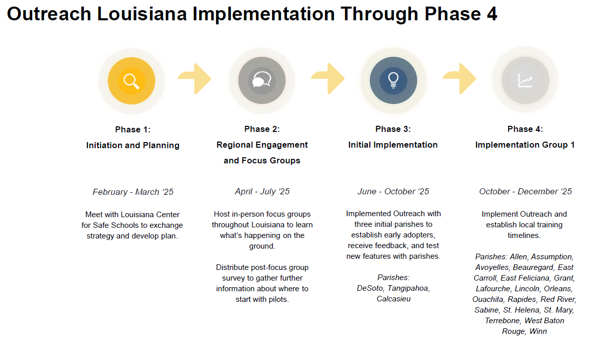
6.1 Updates from LCSS
September - November 2025: Held (21) Initial Introductory Parish Meetings, including the New Orleans Archdiocese Catholic Schools. Two additional parishes were added to (Group 1), Ascension and St. Martin. These parishes are in Phase 4 implementation for scheduling visits and training.

Slide 14
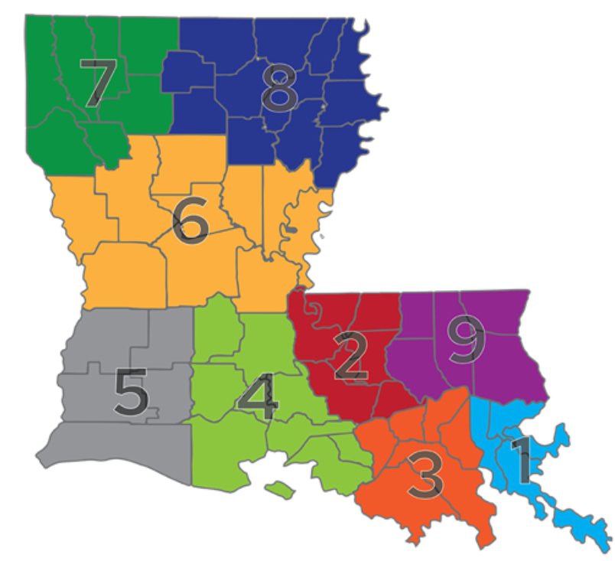
6.1 Updates from LCSS
E. ALL AREA COORDINATORS
Attended Regional OHSEP Director Meetings
Attended Regional LERN Meetings
Live Scenarios for Pointe Coupee Schools
Presented at Louisiana Emergency Managers Conference
Presented at LA School Facility Managers Conference
Attended K-12 School Safety Task Force Meetings
DOE Collaboration Meetings
Traveled to Maryland and Virginia
Continued school support
Working on School Safety Summit, Data Call, and Grants
SAVE THE DATE!
July 7 and 8, 2026
Lake Charles Event Center

Slide 15

F. Stop-the-Bleed Initiative
6.1 Updates from LCSS
Kits Issued as of 09/03/2025:
SWAT-T: 981
TMT: 695
Curads: 703
Total: 2,379 kits
Kits Remaining as of 11/24/2025:
SWAT-T: 42
TMT: 78
Curads: 220
Total: 340 kits
Kits Issued as of 11/24/2025:
SWAT-T: 981
TMT: 725
Curads: 700
Total: 2,406 kits

Slide 16

6.2 Updates From LA State Police & Fusion Center

Slide 17


LSP Louisiana School Safety Initiative

Slide 18
6.3 Mr. Brooks David, District Safety Officer for Vermillion Parish School Board

Slide 19
6.4 FY 24 Grant Carryover Funds

Slide 20

6.5 Additional New Business

Slide 21
6.5.1 LCSNS Vice Chairman Position

Slide 22




6.6 Next Commission Meeting Date
FirstPrintable
FirstPrintable
Mark your calendars!
The next Commission Meeting will be held on
March 26, 2026.

Slide 23

7.0 Adjournment
Thank you so much for attending!!!
We look forward to seeing you at the next meeting!

